Slide 1

Georgia Crisis Response System for
Individuals with Developmental Disabilities (GCRS-DD)
Clint Trusty, M.S., BCBA Senior Behavior Analyst
Georgia Division of Developmental Disabilities
Department of Behavioral Health & Developmental Disabilities
The Division of Developmental Disabilities
1

Slide 2
What is the GCRS-DD?
Provides time-limited home and community based crisis services.
Provides an alternative to institutional placement, emergency room care, and/or law enforcement involvement including incarceration.
The Division of Developmental Disabilities
2

Slide 3

How was the GCRS-DD designed?
Formed work group of stakeholders
Divided into sub-groups for design areas
Developed draft plan
Posted draft plan on web for input
Revised draft plan based on input
The Division of Developmental Disabilities
3

Slide 4


GCRS-DD Standards Development
Based on draft plan for GCRS-DD
Built on clinical standards of practice
Formed for each component of system
The Division of Developmental Disabilities
4

Slide 5
What Should I Expect from GCRS-DD
Georgia Crisis Access Line (GCAL)
  Initial Assessment
  Telephonic Resolution
  Mobile Crisis Team Dispatch
Mobile Crisis Team Support
  Arrival Time of 1.5 hours or less
  Assessment
  On-site Resolution if possible
The Division of Developmental Disabilities
5

Slide 6
What Should I Expect from GCRS-DD
Intensive In-home Supports
  Team works with Family or Provider to provide time limited supports in individual’s home
  Discharge Planning / Training
□ Intensive Out of Home Supports
Transportation of Individual to and from Crisis Home
Partnership with Crisis Home Staff
Discharge Planning / Training
The Division of Developmental Disabilities
6

Slide 7

Who is eligible for GCRS-DD Services?
An individual five years or older with:
documented evidence of an intellectual/developmental disability prior to age 18
related developmental disability diagnosis prior to age 22
screening indicative of a developmental disability for other individuals.
The Division of Developmental Disabilities
7

Slide 8
When is the GCRS-DD to be used?
As a last resort undergoing an
acute crisis described as follows:
The Division of Developmental Disabilities
8

Slide 9
How is the GCRS-DD to be used? Continued
The individual is an imminent harm to self or others.
The individual is in need of immediate care, evaluation, stabilization or treatment due to the risk.
The individual has no available appropriate community supports to meet his or her needs.
The Division of Developmental Disabilities
9

Slide 10

Georgia Crisis Access Line (GCAL)
The Division of Developmental Disabilities
10

Slide 11
Intake Requirements- GCAL
GCAL staff should attempt to resolve the crisis situation through telephonic crisis intervention.
If the call originates from a DD service provider, GCAL is to engage that provider during the resolution of the crisis,
The Division of Developmental Disabilities
11

Slide 12
Intake Requirements- GCAL (Cont’d)
For individuals currently receiving supports and services, GCAL notifies the Regional Office , DD Service Provider, and Support Coordination Agency within 24 hours of receiving a crisis call.
For individual not currently receiving supports and services, GCAL is to make a referral to the Regional I&E Team within 24 hours .
The Division of Developmental Disabilities
12

Slide 13
Intake Requirements- GCAL (Cont’d)
When unsuccessful in resolving the crisis telephonically and an in-person intervention is needed:
GCAL will dispatch the appropriate DD Mobile Crisis Team.
GCAL immediately contacts the Regional Office, SC Agency or SSC/PLA Supervisor, and the DD service provider.
The Division of Developmental Disabilities
13

Slide 14
Mobile Crisis Team (MCT)
The Division of Developmental Disabilities
14

Slide 15
Mobile Crisis Team Requirements
An MCT consist of at least three team members including:
a Licensed Clinical Social Worker (LCSW), behavior specialist, and a direct support staff.
Other team members may include: a registered nurse, an additional social worker (MSW), safety officer, or additional direct support staff.
In addition, a physician will be available for consultation if needed
The Division of Developmental Disabilities
15

Slide 16
Mobile Crisis Team Responsibilities
The DD Mobile Crisis Team is to:
Arrive on site within 1 ½ hours of the GCAL dispatch.
Assess the situation for health and safety risk related to the individual and/or others.
Consult with medical professionals prior to recommending Intensive Crisis Supports.
The Division of Developmental Disabilities
16

Slide 17
Mobile Crisis Team Responsibilities (Cont’d)
Complete comprehensive assessments
Interview the individual, care providers and/or family members,
Observe the current environment,
Review behavior and individual support plans.
The Division of Developmental Disabilities
17

Slide 18
Mobile Crisis Team Responsibilities (Cont’d)
When the DD Mobile Crisis Team makes a disposition the LCSW communicates recommendations within 24 hours to:
Individuals, Families/Caregivers,
Support Coordination Agencies, Provider Agencies,
Regional Office I & E Teams, and Planning List Supervisors
The Division of Developmental Disabilities
18

Slide 19

Intensive Crisis Support Services
The Division of Developmental Disabilities ¹⁹

Slide 20
Intensive Crisis Support Services
Intensive In-Home and Out-of-Home Supports:
□Are time-limited
□Not to exceed 7 calendar days
The Division of Developmental Disabilities
20

Slide 21
Intensive Crisis Support Services (Cont’d)
Intensive Crisis Supports are specialized services that provide:
□Interventions to an individual due to need for supports or for protection of others,
□The recipient the opportunity to remain in the community,
□Enhanced opportunities for the family/provider to meet the needs of the individual.
The Division of Developmental Disabilities
21

Slide 22


Criteria for Intensive Services
In-home
Out-Of-Home
VS.
22

Slide 23

Intensive In-Home Supports
Mobile team unable to mitigate crisis in reasonable time
OR
Crisis resolved but environment or individual’s lack of skills make another crisis imminent
AND
Caregiver or provider staff not capable of providing necessary intervention and protection for individual or others in the home AND
Intensive supports will allow individual to avoid institutional placement

Slide 24


Intensive Out-of-Home Supports
All of the Intensive in-home supports criteria
AND
The safety of others living in the home cannot be maintained through Intensive In-Home Supports OR
Extensive environmental modifications are needed as a result of the crisis and the individual cannot reside in home during that time

Slide 25

Intensive In-Home Support Service
The Division of Developmental Disabilities
25

Slide 26
Intensive In-Home Supports
Services include but not limited to:
  Implementation of behavior intervention strategies, safety plans, or behavior plans
  Provision of one-to-one support
  Modeling of interventions with family or provider staff
  Assistance with environmental adaptations
  Accompanying individual to appointments related to crisis response

Slide 27



Intensive In-Home Supports
Staffing:
  Up to 24 hours per day, 7 days per week
  Intensity should decrease over 7 calendar days

Slide 28

Intensive Out-of-Home Support Service
The Division of Developmental Disabilities
28

Slide 29
Intensive Out-of-Home Support Service
Individuals under the age of 18 years are served in a Temporary & Immediate Supports Home (TIS).
Intensive Out-of-Home Supports are to:
  Stabilize the individual through nursing and behavioral supports,
  On a time-limited basis not to exceed 7 days,
  Serve no more than four individuals simultaneously.
The Division of Developmental Disabilities
29

Slide 30

What is Expected of the Provider
Utilize the system for unplanned events or failed crisis/safety plans ONLY
Partner with the Mobile Crisis Team and Intensive Support Services Staff
Implement recommendations made by crisis system staff
The Division of Developmental Disabilities
30

Slide 31
DD Crisis Response System Quality Review
GCRS-DD Providers must comply with the Operating and Clinical Standards and the Community Services Standards for DD Provider.
Prior to operating the GCRS and Intensive Out-of- Home Crisis Support Homes, an on-site quality review of the crisis support home is conducted by the DD Provider Compliance Unit.
A Provisional Certificate of Compliance demonstrating approval to provide the intensive out of home support services is required to provide services.
The Division of Developmental Disabilities
31

Slide 32
DD Crisis Response System
Quality Review cont.
Approximately six months after the initial review, a comprehensive review will be conducted to ensure adherence to both the Operating and Clinical Standards and the Community Services Standards for DD Provider and the implementation of the program requirements.
A Certificate of Compliance up to two years will be given for achieving full compliance with the standards requirements.
The Division of Developmental Disabilities
32

Slide 33
What is Expected of the Provider
Make plans to avoid future use of the system for the same situation and/or individual
  The goal is for you to be equipped to handle individuals you serve on your own
The Division of Developmental Disabilities
33

Slide 34


Outcomes
(June 1, 2011 – March 31, 2012)
The Division of Developmental Disabilities
34

Slide 35
Calls to Georgia Crisis Response System
The Division of Developmental Disabilities
35

Slide 36
Data (June 1, 2011 – June 30, 2012)
3076 calls to Georgia Crisis Access Line (GCAL)
  57% were crisis calls.
  74% of Crisis Calls had DD as Primary Presentation
  36% of Crisis Call had MH as Primary Presentation.

Slide 37
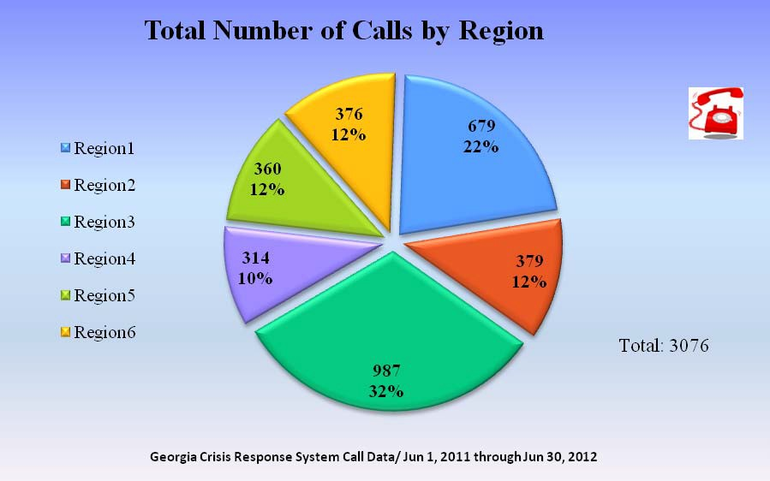
Call Breakdown by Region

Slide 38
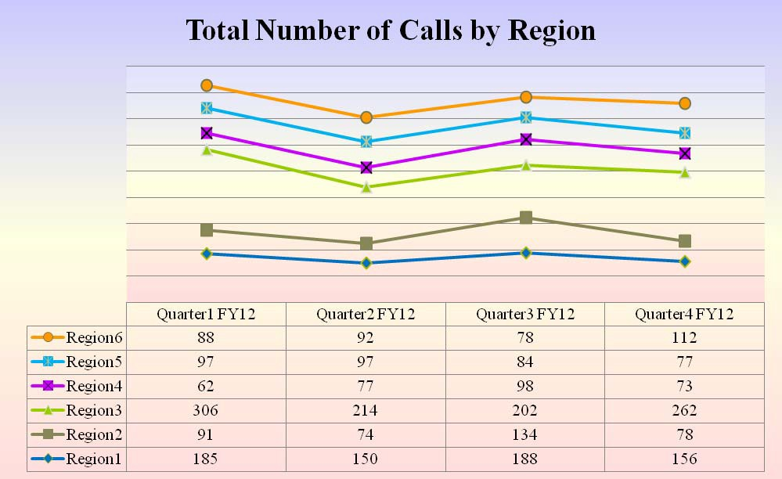
Call Breakdown by Region

Slide 39
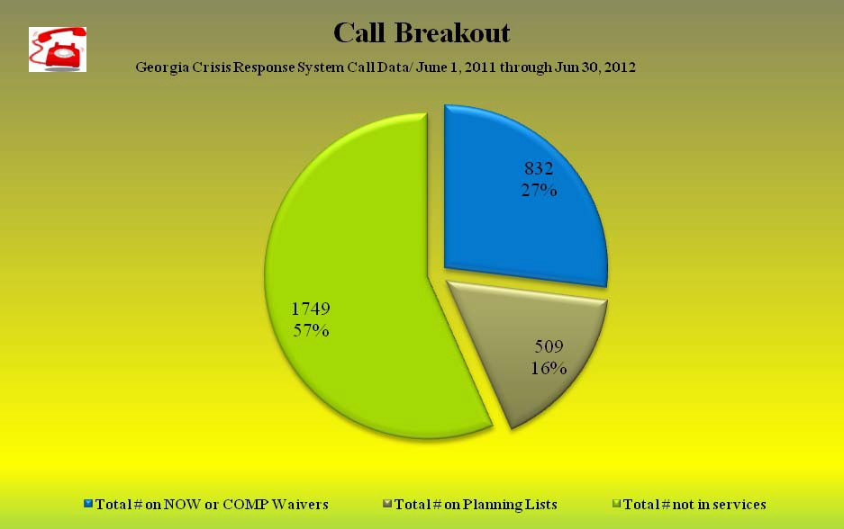
Call Breakout by Supports

Slide 40
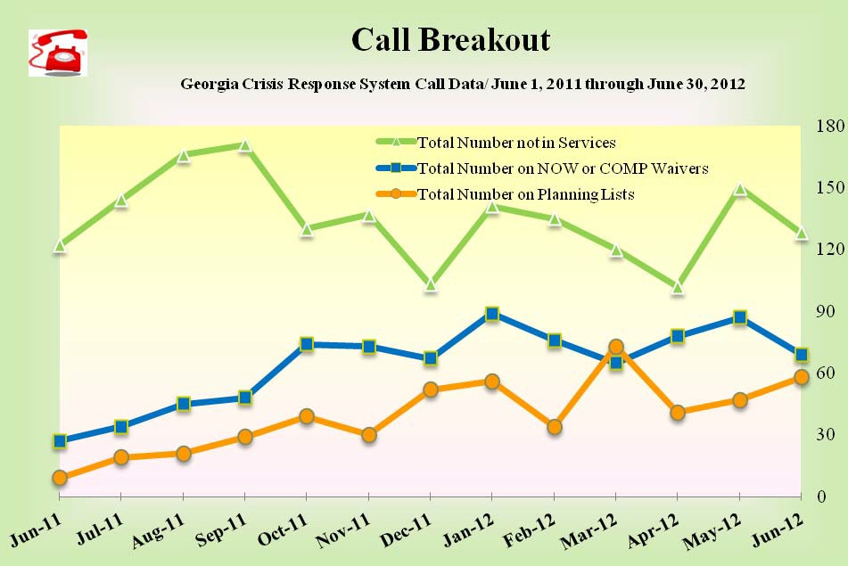
Call Breakout by Supports

Slide 41
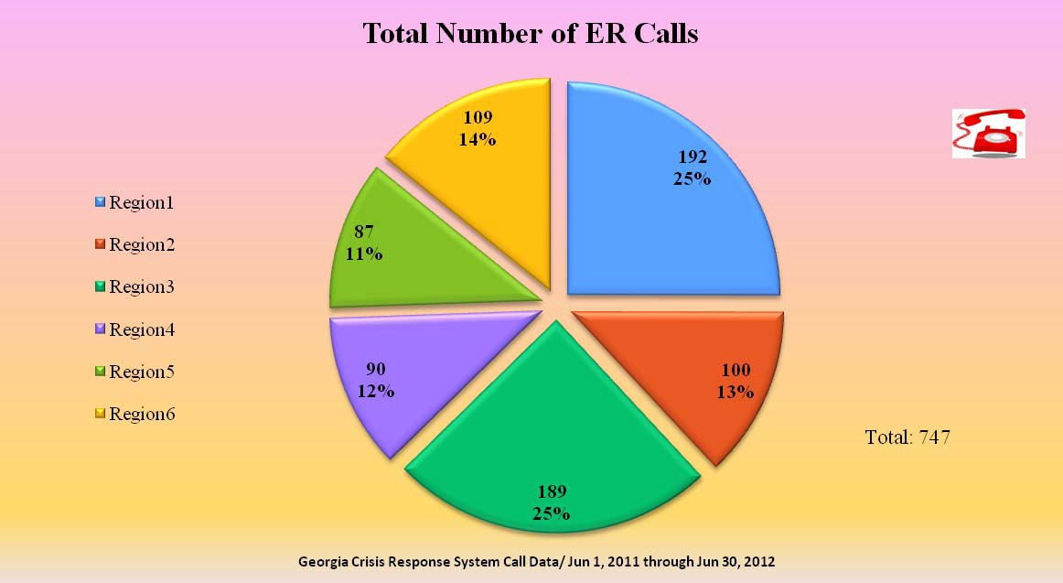
Emergency Room Calls

Slide 42
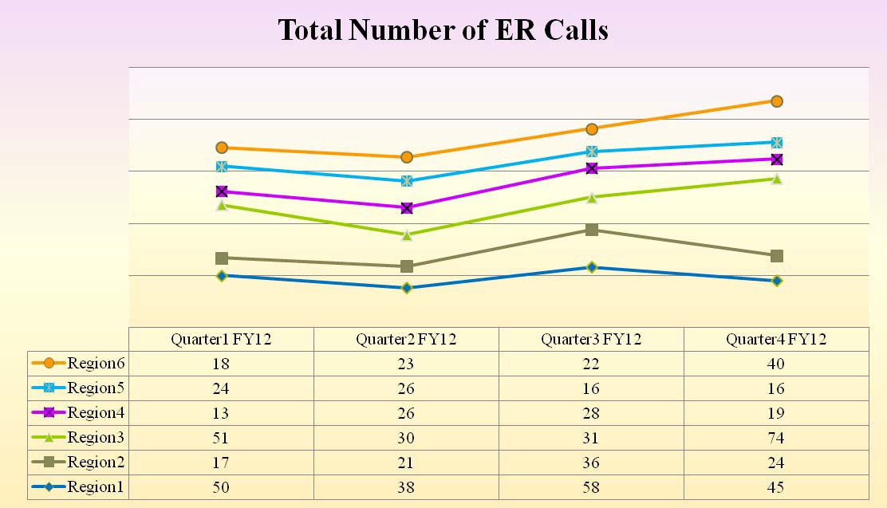
Emergency Room Calls

Slide 43
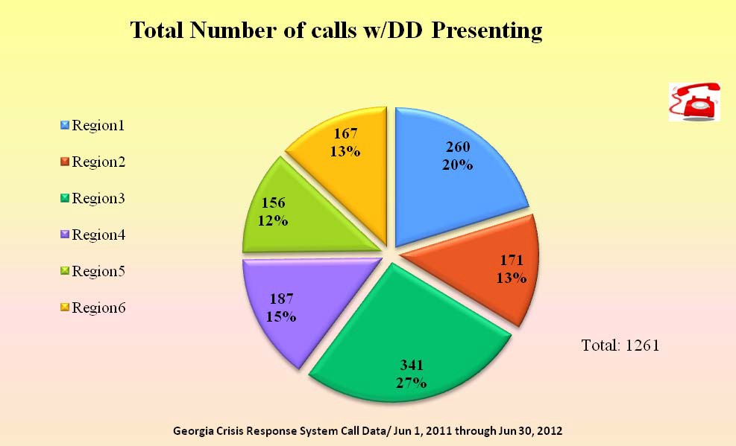
Calls with DD Presenting

Slide 44
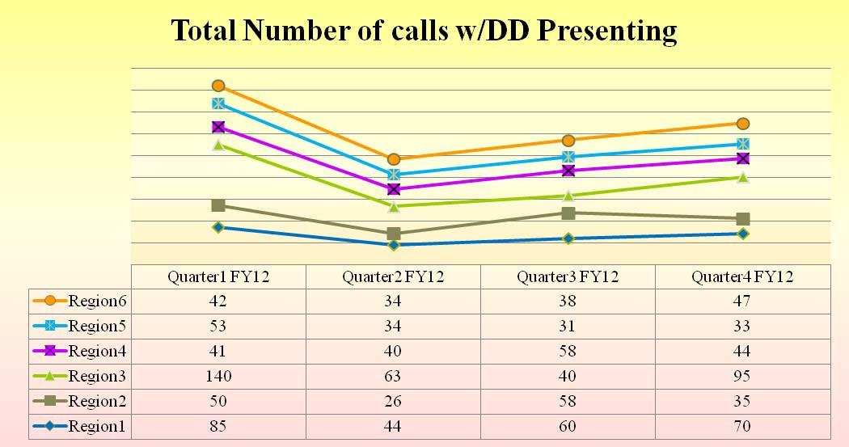
Calls with DD Presenting

Slide 45
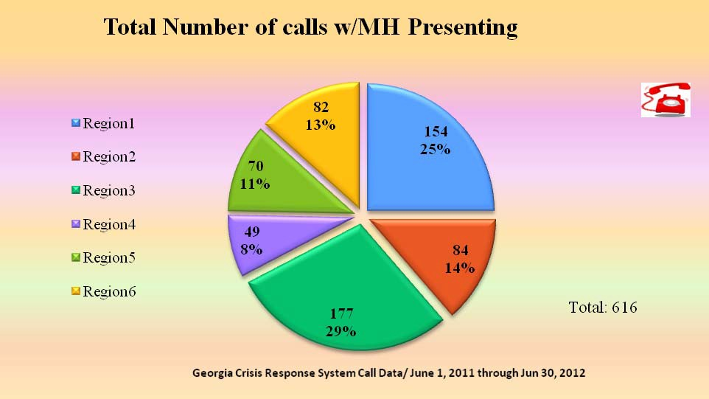
Calls with MH Presenting

Slide 46
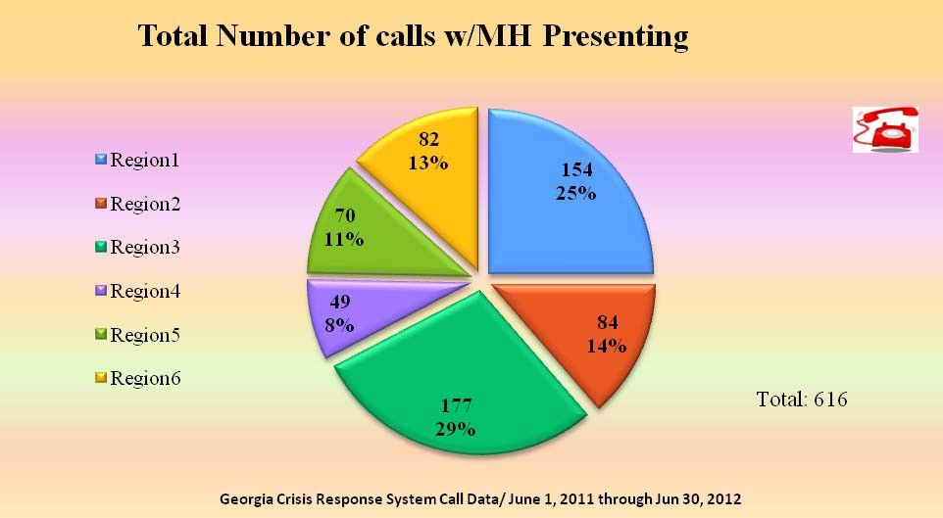
Calls with MH Presenting

Slide 47
Crisis Calls
1711 Crisis Calls
  74% with DD Presenting
  35% with MH Presenting
  27% were under 18 years of age
815 (48%)Mobile Crisis Team Dispatches
  25% of Dispatches were under 18 years of age

Slide 48
Results of MCT Dispatch*
Of the 815 MCT Dispatches
  575 dispatches resulted in crisis being eliminated either at the time of crisis
  135 resulted in the need for additional In-Home Supports
  105 resulted in individuals being relocate to a Crisis Home

Slide 49
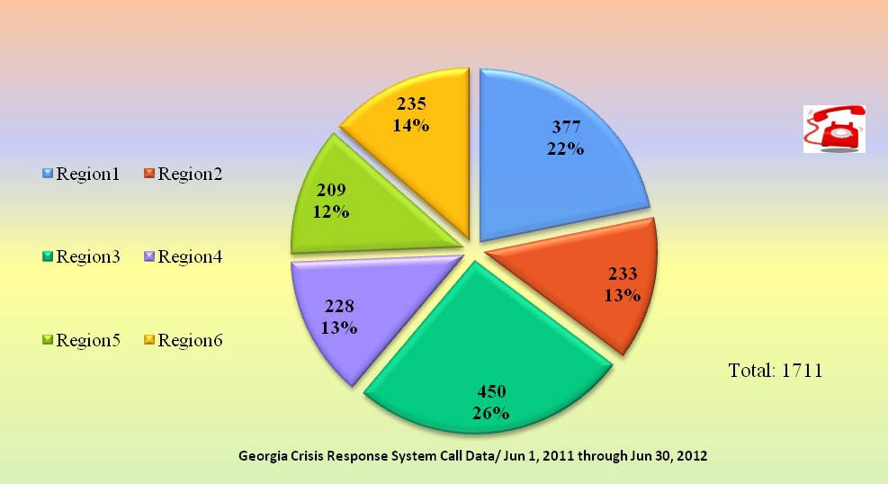
Crisis Calls by Region

Slide 50
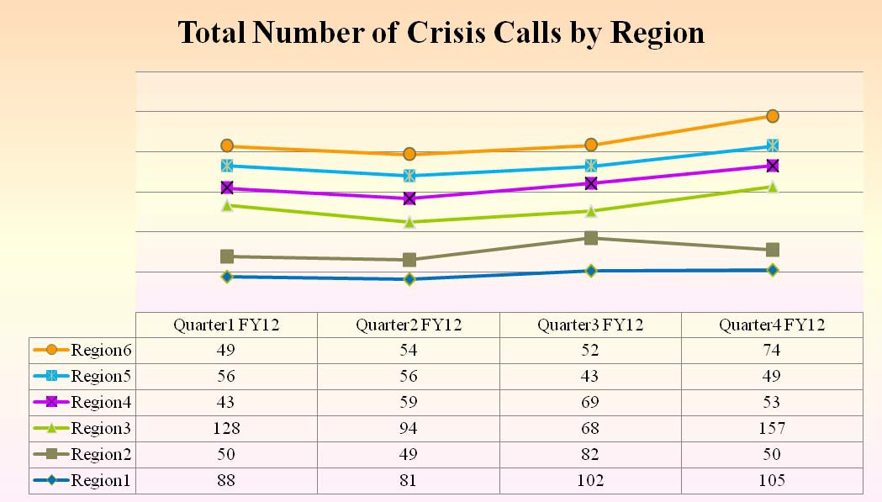
Crisis Calls by Region

Slide 51
Telephonic Resolution
899 (52%) Crisis Calls were resolved telephonically.

Slide 52
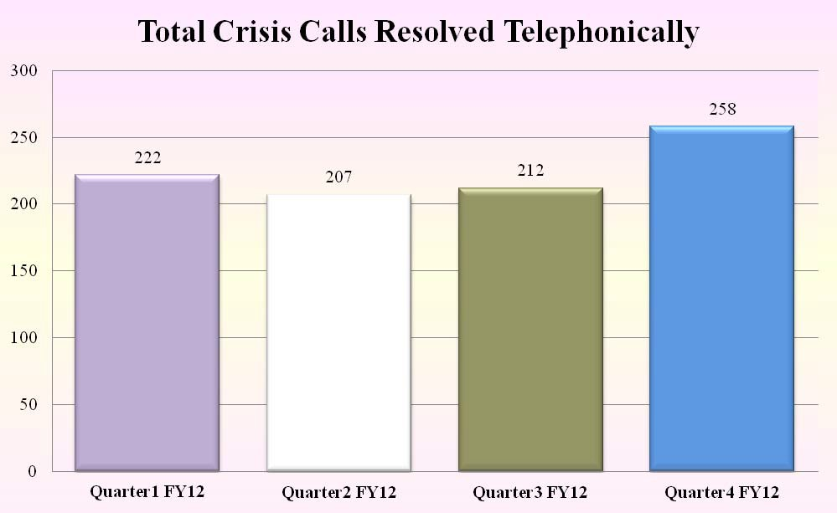
Telephonic Resolution

Slide 53
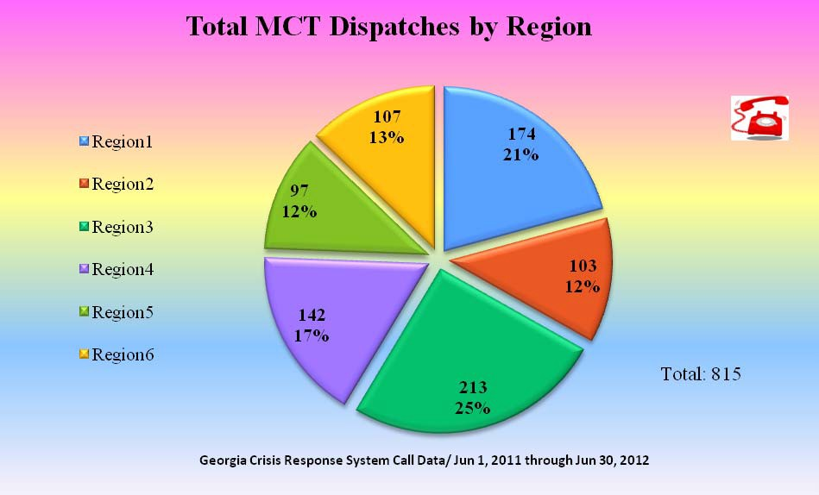
Mobile Crisis Team Dispatch

Slide 54
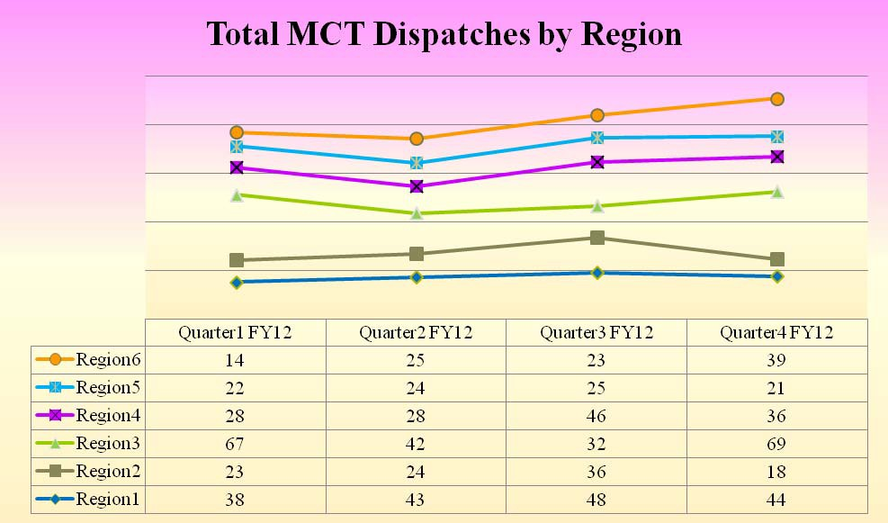
Mobile Crisis Team Dispatch

Slide 55
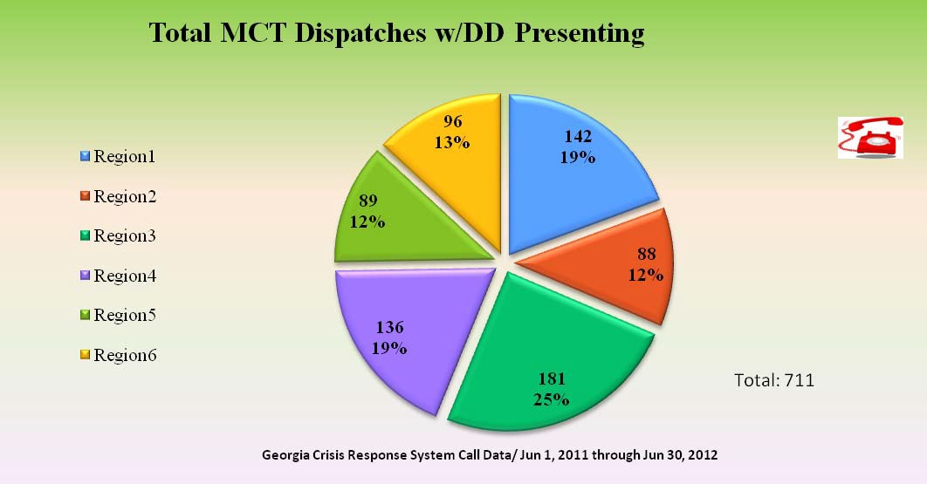
Mobile Crisis Team Dispatch

Slide 56
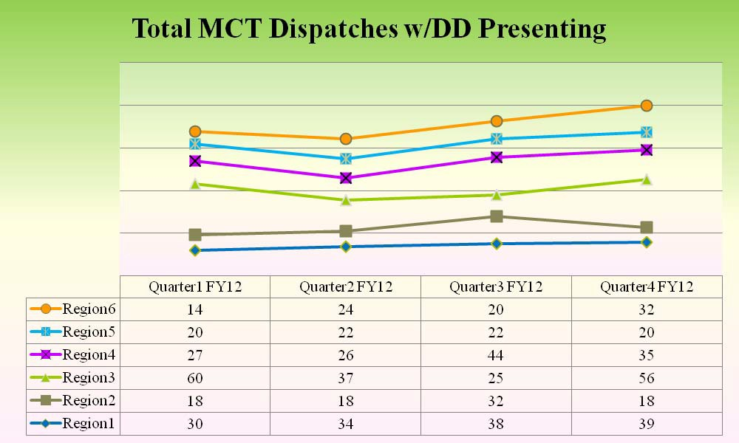
Mobile Crisis Team Dispatch

Slide 57
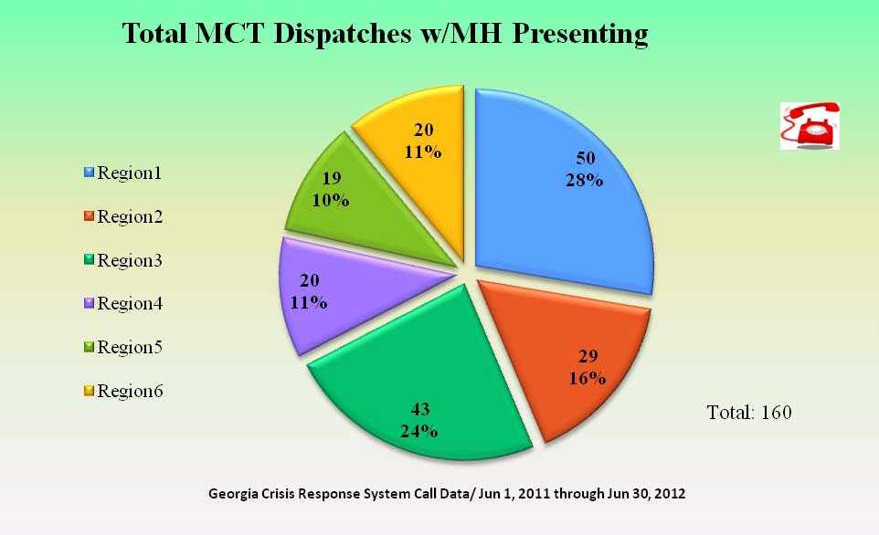
Mobile Crisis Team Dispatch

Slide 58
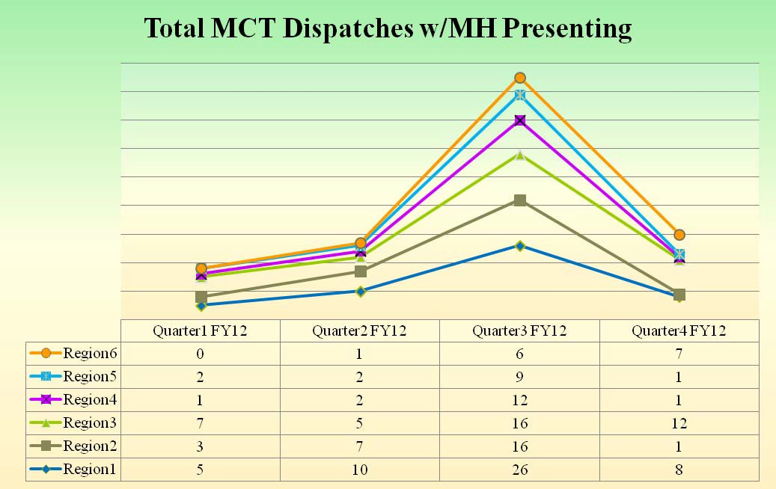
Mobile Crisis Team Dispatch

Slide 59
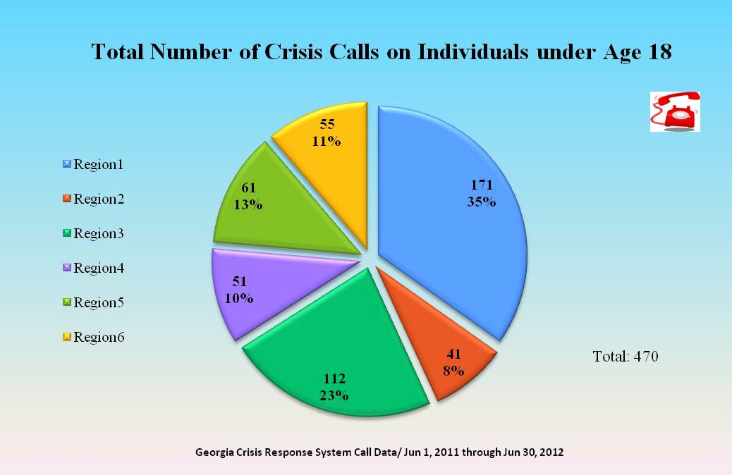
Crisis Calls Under 18 Years of Age

Slide 60
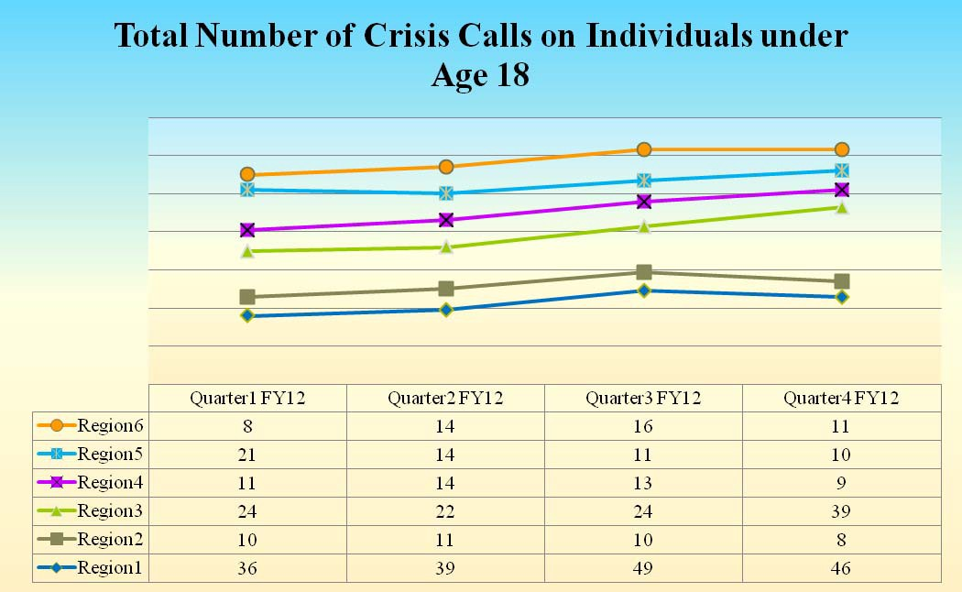
Crisis Calls Under 18 Years of Age

Slide 61
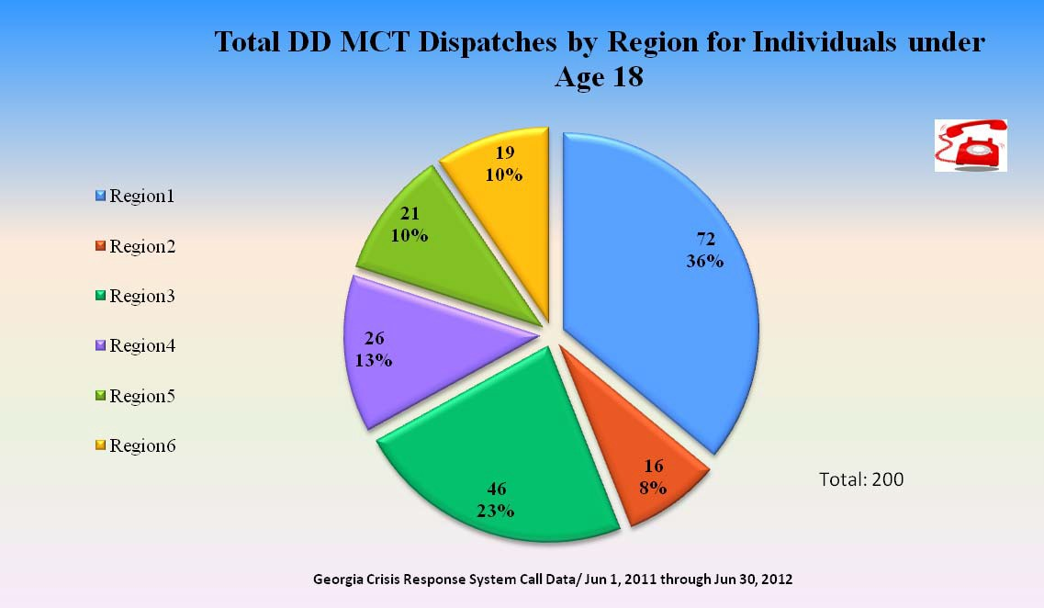
MCT Dispatch Under 18 Years

Slide 62
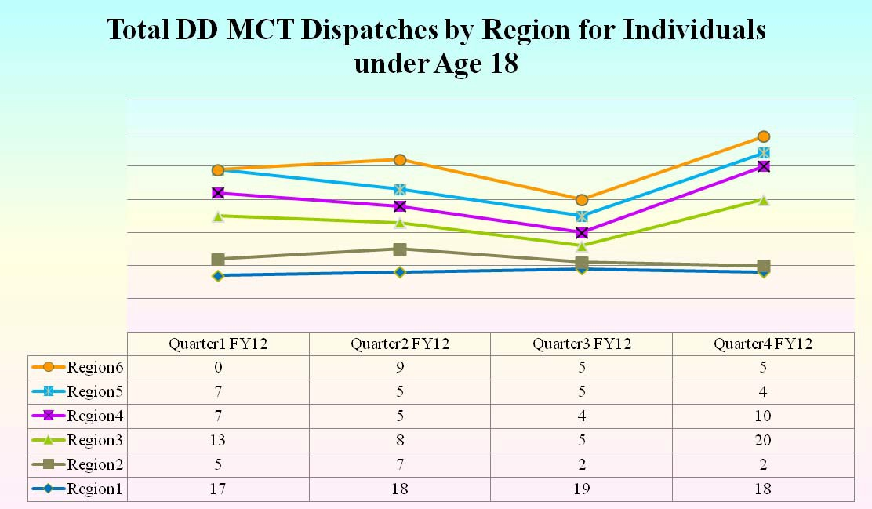
MCT Dispatch Under 18 Years

Slide 63
Lesson’s Learned
Majority of calls are from individuals not currently receiving supports or services.
Majority of Individuals can be supported in their homes without the need for hospitalization.
The Division of Developmental Disabilities
63

Slide 64
Lesson’s Learned
Dually Diagnosed Individuals present a challenge for the System.
  Department is taking steps to increase the collaboration and partnerships between MH and DD.
The Division of Developmental Disabilities
64

Slide 65
Links
Georgia Crisis Response System: www.ddcrisis.org
Georgia Crisis and Access Line (GCAL): 1-800-715-4225
The Division of Developmental Disabilities
65

Slide 66
Georgia Crisis Response System for
Individuals with Developmental Disabilities (GCRS-DD)
Questions?
Department of Behavioral Health & Developmental Disabilities
The Division of Developmental Disabilities
66

